Slide 1

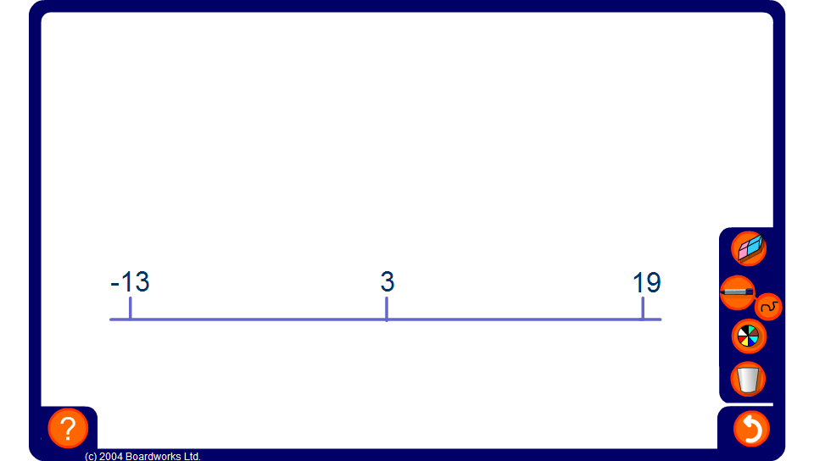


Mid-points
Notes:
Explain to pupils that we wish to find the number that is exactly half-way between the other two. Reveal all three numbers as an example.
Generate a new example and reveal the two end-points. Ask pupils to justify their answers. Vary the activity by revealing the mid-point and one of the end-points.
As an extension include negative decimals.
Links:
N1 Place value, ordering and rounding - ordering decimals.
D3 Representing and interpreting data – calculating the mean

